Slide 1


Agentic AI with LangChain and LangGraph
Presentation 2: Some Good-to-Know Foundations
Primary Instructor: Michael Z
RA: YH
Date: 2026.Jan-Feb

Slide 2
0. A little bit of Review of Presentation 1

Slide 3
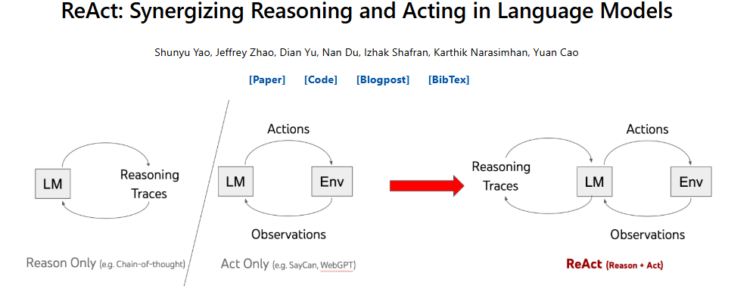
0. A little bit of Review of Presentation 1: Re and Act
I might have, or might haven’t dived into the details of ReAct in presentation but here we are:
(DeepSeek R1?)
(I think we could watch SayCan video)

Slide 4
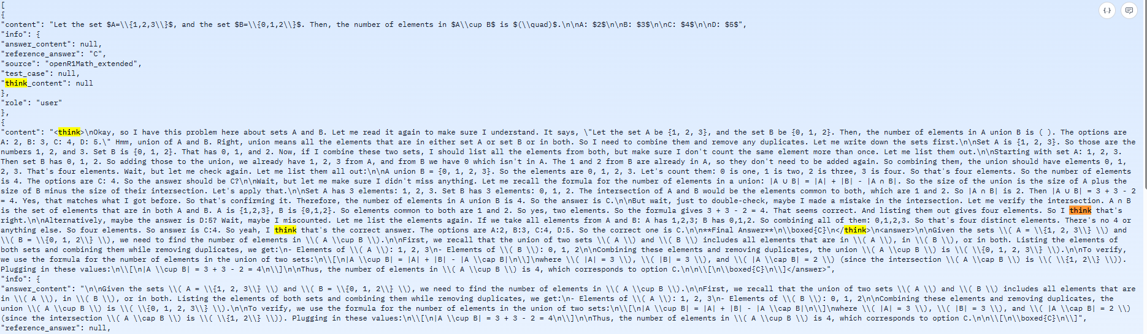
0. A little bit of Review of Presentation 1: Reasoning
LLM’s reasoning capability is obtained through training (to be specific, it’s post-training. Would talk about it later.).
One entry from the train dataset is presented below to you:

Slide 5
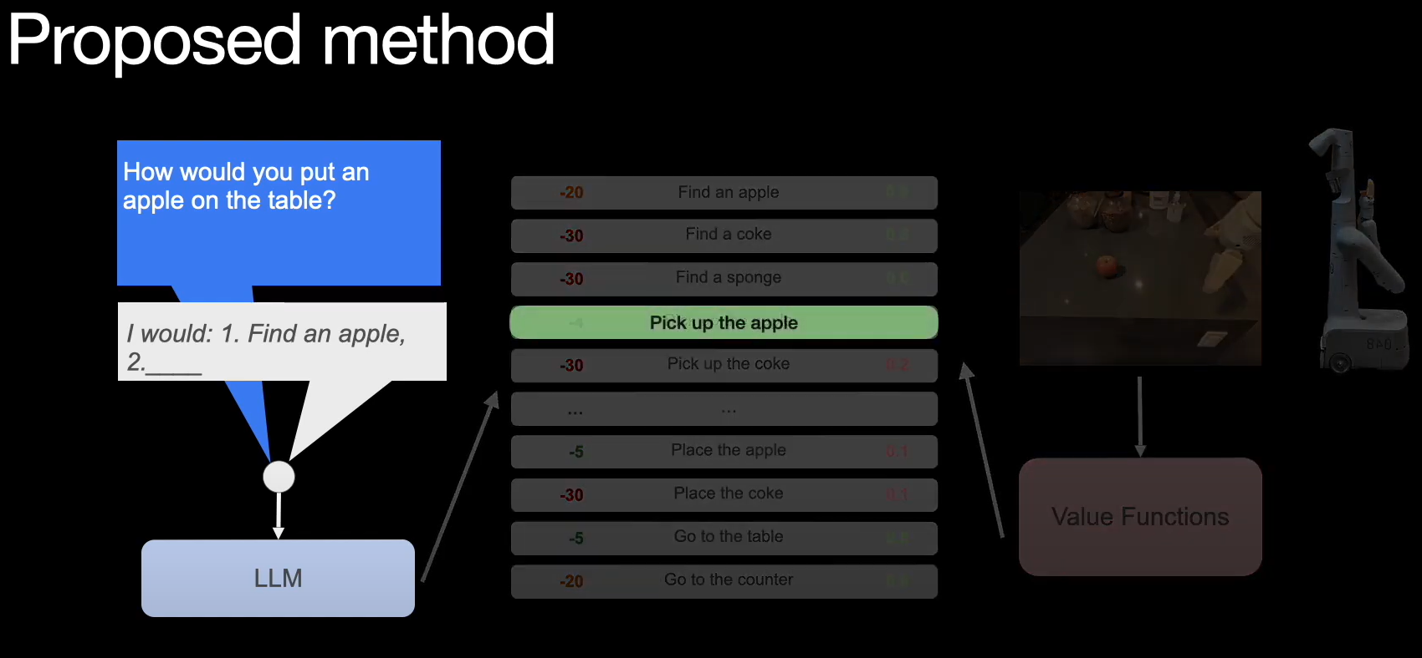
0. A little bit of Review of Presentation 1: Acting (SayCan)
Each phrase corresponds to one action. Similarly, acting ability is also obtained through training (post-training).

Slide 6
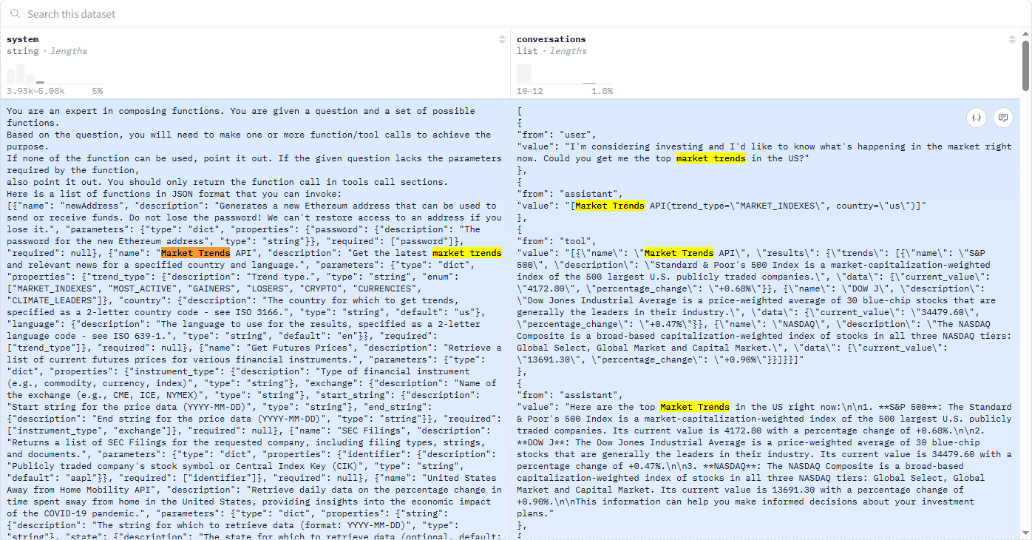
0. A little bit of Review of Presentation 1: ReAct
ReAct architecture requires LLMs to output tool messages in a specific format to call tools. And then, these tool messages would be parsed and sent to functions for execution. Finally, these tools would return outcomes (Observations) back to LLM.
Notably, ability of calling tools is also obtained through post-training.

Slide 7
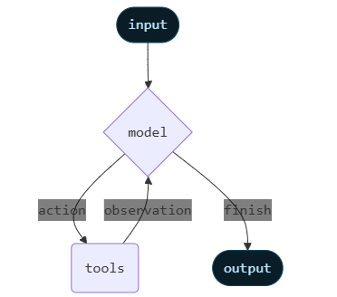
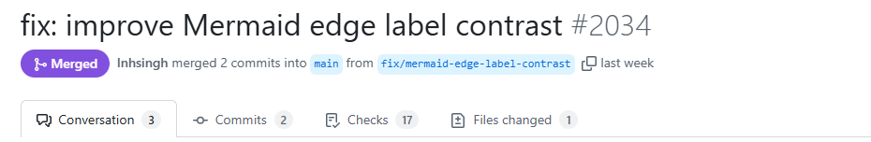
0. A little bit of Review of Presentation 1: A nice chart
Input goes into LLM.
LLM might or might not reason, then would or would not take actions (call tools).
If tool is called, observation would be returned to inform reasoning or next action.
Then steps above repeat until LLM thinks it’s finished. Then output is returned to user.
This is the biggest takeaway you need from this tutorial. I hope you won’t forget this after you graduate!!!
Figure 1: LangChain illustration of ReAct
Figure 1 Source: https://docs.langchain.com/oss/python/langchain/agents
(Image above was the one I copied from LangChain docs in Dec.2025 but recently it was “fixed”. So, the one you could see right now is little bit different from the one I posted here. FYI.)

Slide 8
(Q: You blah blah blah “post-training” several times. What does it mean?
A: My bad. Here we are.)
1. How a LLM is trained from scratch?
(No worries you won’t do this in this tutorial. But feel free to do it on your own if you have GPUs!!!)

Slide 9
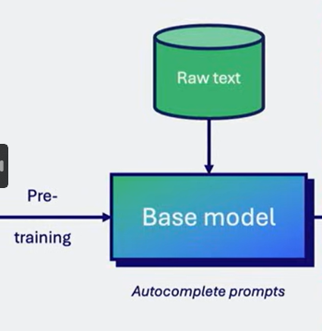
1. How a LLM is trained from scratch?: Pre-Training
Initially, a LLM is randomly initialized. It could do nothing but output nonsense, which makes sense.
Then, developers want to train it using QA pairs, which is what we think when dealing with other models. But human being don’t have that many high-quality QA pairs. And hiring someone to make QA pairs is prohibitively expensive.
So, developers came up with an idea that LLM learns everything on its own first through learning how to predict next token (pretext task).
(To learn more about pretext task, please refer to self-supervised learning.)
Then, LLM could auto-complete prompts. At this moment, this is called base model.
(When you are downloading LLMs from HuggingFace, if the name of LLM doesn’t contain “instruct”, it’s base model by default, except gpt-oss-20b and 120b. If it contains “base”, it’s base model.)
Figure 2: Pre-Training
Figure 2 Source: https://github.com/mlabonne/llm-course

Slide 10
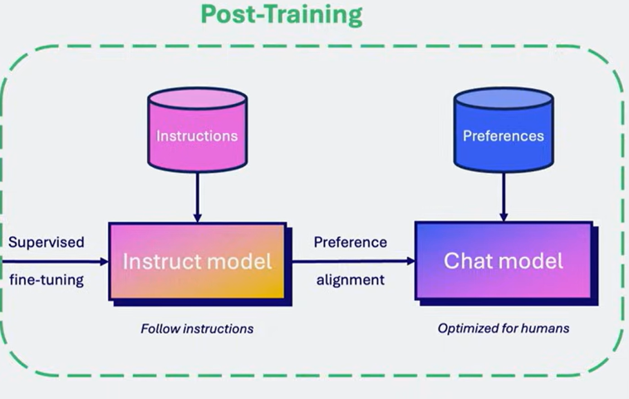
1. How a LLM is trained from scratch?: Post-Training
And then, developers train base model using QA, Instruction-Response pairs and then it would become Instruct Model.
Actually, instruct model is usable.
But to meet human preference further. Instruct model would be trained further using RL or whatever I can’t name here.
(If you are prompted by ChatGPT to choose which response you like, what’s taking place is alignment. But once I realized I was helping them to train model and I didn’t get paid, I stopped choosing response for them 😈.)
(Since it’s not a LLM course, I would not dive into details but feel free to learn LLM basics on your own.)
Figure 3: Post-Training
Figure 3 Source: https://github.com/mlabonne/llm-course

Slide 11


1. How a LLM is trained from scratch?: An inappropriate example
(An appropriate explanation involves topics of self-supervised learning, which won’t be discussed here.)
(If you have never heard about Scratch, I would open the browser and search it for you.)

Slide 12
2. What are the problems of tools calling after you learned how capability of tools calling is obtained?
(I think I would interact with you guys for couple mins so please speak something 👀)

Slide 13
(For some reasons, some vendors’ LLMs don’t have the capability of calling tools through API………..)
(It sounds weird, but it did once happen to me)

Slide 14
3. Some Commonly-Used Generation Config of LLM

Slide 15
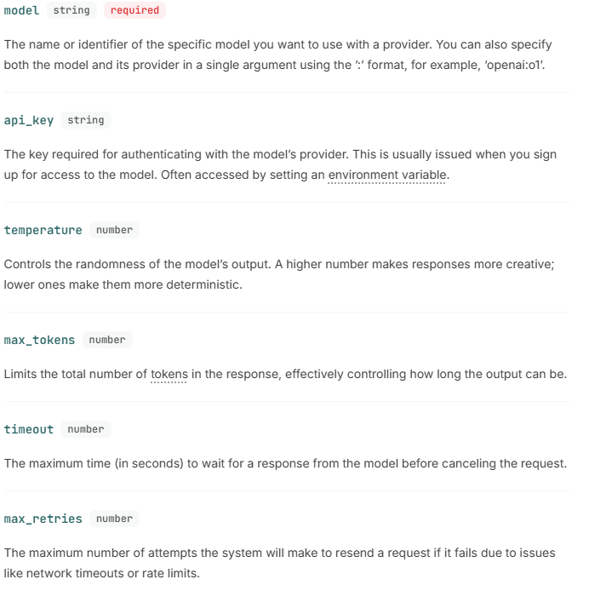
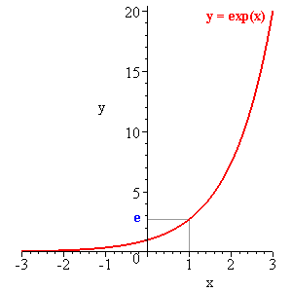

3. Some Commonly Used Generation Config of LLM
Different models would support different parameters, but they all support these 6 parameters.
This is where temperature comes in:
If you are interested in all parameters that could control how LLM outputs response, Please refer to Generation Configuration of HuggingFace (Don’t ask me when you don’t understand some of these parameters 😭).
https://huggingface.co/docs/transformers/en/main_classes/text_generation#transformers.GenerationConfig
Since we are not learning LLM, I won’t dive into details a lot.

Slide 16
4. Warm-Up

Slide 17
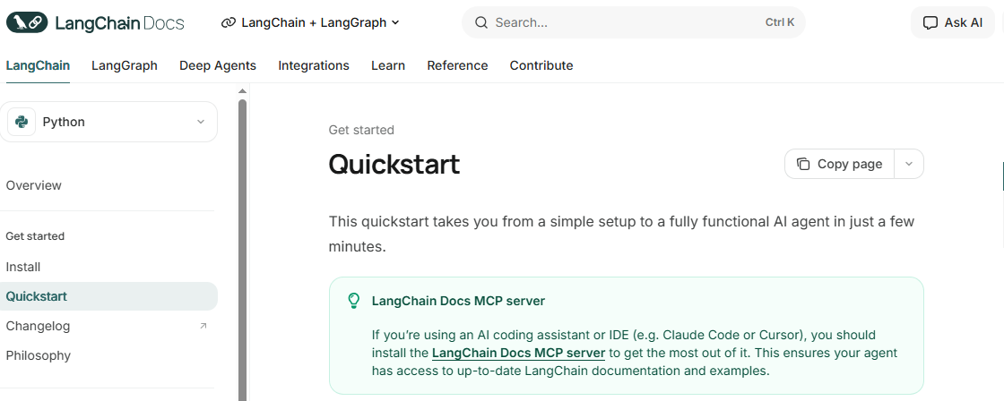
4. Warm-Up
Since we are going to dive into the fundamentals of LangChain in next presentation, you should do their QuickStart on your own.
If you find it too easy, congrats! It means you don’t have to follow my pace, and you can learn it by yourself from the docs.
(Docs could be wrong and I fixed some errors for LangChain. For the most accurate information please refer to their reference.)
(Why docs != reference for LangChain? I am curious 🤔)
(If you run into any issues, just simply reach out to Yilong or me, rather than Michael.)
(We are using OpenAI API key so please simply replace Anthropic LLM with gpt-4o or others.)
(Put your API key in .env and use os.getenv() to get the value and pass it in to the init_chat_model)
(Some functions used in QuickStart would be discussed in the upcoming presentations. So, for now, just enjoy programming without actual understanding.)

Slide 18
4. Warm-Up: Couple of Questions btw
(If you can’t answer that’s okay….)
Is the tool decorator optional?
What does dataclass decorator do?
What are the differences between user prompt and system prompt? (open question, which means no standard answer.)
Can the agent call a tool if name of this tool is removed from system prompt?
……….

Slide 19
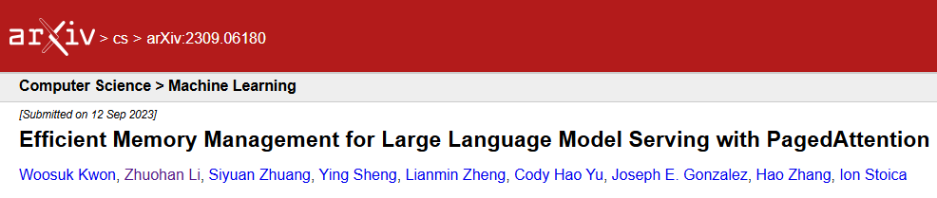
Thank you for your paged attention!

Slide 20


